Slide 1

DIGITAL COMMUNICATION (UE21EC242B)
IMPLEMENTATION OF ADAPTIVE DELTA MODULATION
Sumukh Shadakshari, PES1UG21EC302
Venkat Raghavendra, PES1UG21EC333
Suhas Nagraj Bharadwaj, PES1UG21EC299
Srinivasa Puranika Bhatta, PES1UG21EC295

Slide 2
OBJECTIVE
To implement delta modulation (DM) and adaptive delta modulation (ADM) using Python.
We shall implement three techniques of adaptive delta modulation: the BM Jayant method, Song method, and the modified Song method. The resultant waveforms and the signal to noise ratios obtained from the three techniques are compared to that of delta modulation with uniform step size.

Slide 3
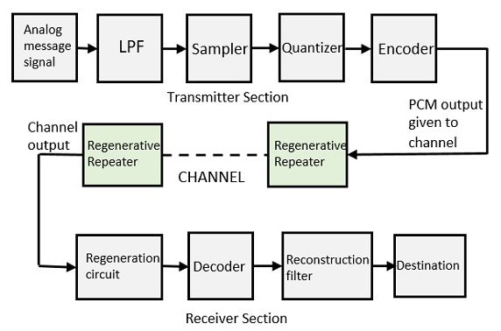
THEORY
Pulse code modulation is the process of representing the sequence of samples by a sequence of bits. Here each sample is represented by a bit pattern. It involves two steps, quantization and bit encoding.

Slide 4
THEORY
For the samples that are highly correlated, when encoded by PCM technique, leave redundant information behind.
To process this redundant information and to have a better output, it is a wise decision to take a predicted sampled value, assumed from its previous output and summarize them with the quantized values.
This process is known as the Differential PCM (DPCM) technique.
In DPCM, the error (difference between the actual signal and predicted signal) is quantized.

Slide 5
THEORY
Delta Modulation is a simplified form of DPCM technique, also viewed as 1-bit DPCM scheme.
Delta Modulation is a DPCM quantization scheme that uses two levels of quantization (i.e., one bit quantizer). By using a single bit to represent each sample, the sample rate and the bit rate are equivalent.
As PCM has the property of converting a message signal directly into a sequence of a binary coded pulse, this leads to increase in the bandwidth requirement of the system. Thus, in order to reduce the bandwidth requirement of the system, delta modulation is used.

Slide 6
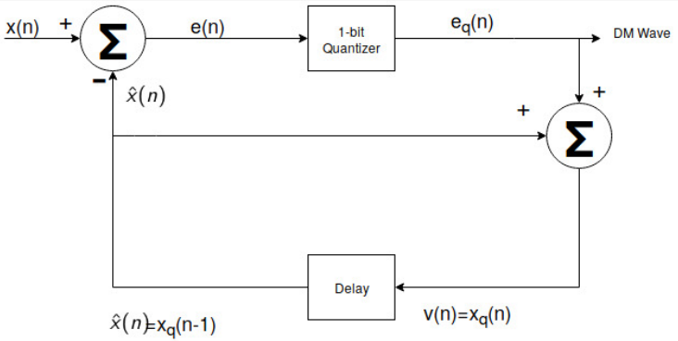
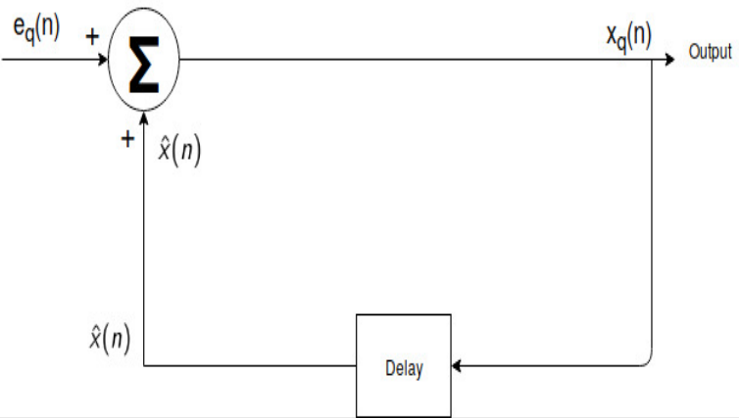
THEORY
Delta Modulation Transmitter:
Delta Modulation Receiver:

Slide 7
THEORY
Signalling Rate for ∆ modulation = 𝑛*𝑓𝑠
Transmission Bandwidth for ∆ modulation= 𝑛*𝑓𝑠/ 2
In delta modulation n=1
Therefore, BW= 𝑓𝑠/ 2

Slide 8
THEORY
Advantages of Delta Modulation over DPCM:
Since, delta modulation transmits only one bit for one sample, therefore the signaling rate and transmission channel bandwidth is quite small for delta modulation compared to PCM .
The transmitter and receiver implementation is very much simple for delta modulation. There is no analog to digital converter required in delta modulation.

Slide 9
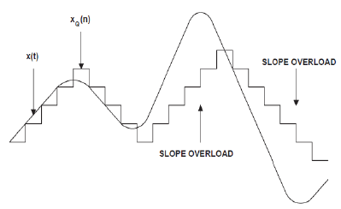
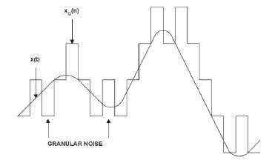
THEORY
Disadvantages of Delta Modulation:
Slope Overload Error
Granular Error

Slide 10
THEORY
Slope overload error:
This distortion arises because of large dynamic range of the input signal.
From the figure, the rate of rise of input signal x(t) is so high that the staircase signal can not approximate it, the step size ‘Δ’ becomes too small for staircase signal u(t) to follow the step segment of x(t).
Hence, there is a large error between the staircase approximated signal and the original input signal x(t).

Slide 11
THEORY
Granular Error:
Granular or Idle noise occurs when the step size is too large compared to small variation in the input signal.
This means that for very small variations in the input signal, the staircase signal is changed by large amount (Δ) because of large step size.
Figure shows that when the input signal is almost flat , the staircase signal u(t) keeps on oscillating by ±Δ around the signal.

Slide 12
THEORY
Adaptive Delta Modulation:
A larger step-size is needed in the steep slope of modulating signal and a smaller step size is needed where the message has a small slope. The minute details get missed in the process.
So, it would be better if we can control the adjustment of step-size, according to our requirement, to reduce the slope overload and granular errors.
This is the concept of Adaptive Delta Modulation. It uses variable step size in order to predict the consequent values.

Slide 13
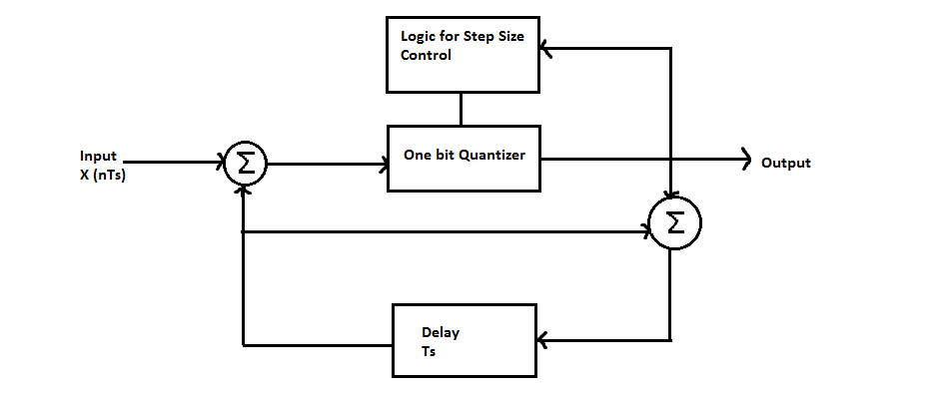
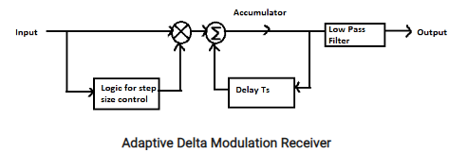
THEORY
Adaptive Delta Modulation:
The only difference in the structure of the transmitter and receiver from normal delta modulation is that they have another feedback path with logic for step size control.

Slide 14
THEORY
The advantages of adaptive delta modulation include the following:
This modulation can be used to reduce the slope error which is present in delta modulation.
This can be used to remove the granular error from the signal.
It has an improved signal to noise ratio as compared to that of delta modulation.
The applications of adaptive delta modulation include the following:
It can be used in systems that require improved voice quality.
It is used in voice coding.
It is used in television signal transmission.
The SECURENET line of Motorola uses 12kbit/sec adaptive delta modulation.
It is used by NASA for different communications between spacecraft and mission control.
The US Army also uses adaptive delta modulation in order to conserve bandwidth over various tactical links.

Slide 15
THEORY
Techniques for Implementation of Adaptive Delta Modulation:
NS Jayant Algorithm:
This algorithm was developed by a scientist NS Jayant in Bell Laboratories. In Jayant ADM, an increase in step size is achieved by multiplication with a constant and decreases it by dividing by the same constant.
If a series of …0000… or …1111… is detected in the encoded signal, the step size is multiplied with a constant k. If a series of ...0101… is detected, the step size is divided by the same contant k.

Slide 16
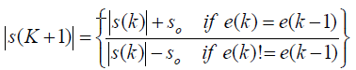
THEORY
2. SONG Algorithm:
Consider s(K) to be the step size of the delta modulated staircase approximation for the kth sample of the input signal.
If the quantized error (e(k-1)) of the previous sample matches the present quantized error, a constant So (minimum step size) is added to the step size of the next sample

Slide 17
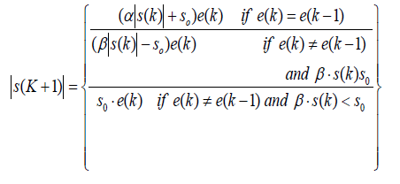
THEORY
3. Modified SONG Algorithm:
α is the adaptation parameter nearly equal to 1 but, greater than 1. β=1/α.
In this algorithm by proper choice of α>1, the rate of change of step-size can be made greater than So.
It is seen that the α parameter gives a better performance to slope overload and the parameter β takes care of the granular noise as a result of which a better performance is obtained as compared to SONG.

Slide 18
IMPLEMENTATION USING PYTHON
Delta modulation with uniform quantization:
import numpy as np
import matplotlib.pyplot as plt
from scipy.signal import butter, filtfilt
def delta_mod(data, delta):
len_data = 500
pred = np.zeros(len_data)
e_hat = np.zeros(len_data)
for i in range(1, len_data):
e_n = data[i] - pred[i-1]
if (e_n >= 0):
e_hat[i] = delta
else:
e_hat[i] = -delta
pred[i] = pred[i-1] + e_hat[i]
encoded = e_hat >= 0
return encoded, pred
def delta_mod_demod(mod_data, delta, f, fs):
len_data = 500
x_dem = np.zeros(len_data)
for i in range(1, len_data):
if mod_data[i] == 0:
e_hat = -delta
else:
e_hat = delta
x_dem[i] = e_hat + x_dem[i-1]
fs = 1000 # Sampling rate (Hz)
fc = 100 # Cutoff frequency (Hz)
order = 4 # Filter order
b, a = butter(order, fc / (fs / 2), 'low')
demod = filtfilt(b, a, x_dem)
return demod

Slide 19
IMPLEMENTATION USING PYTHON
def isnr(x, y):
noise = x - y
mse = np.mean(np.square(noise))
return 10 * np.log10(np.mean(np.square(x))/mse)
# Sin*Exp input
len_data = 500
t = np.linspace(0, 10, len_data)
Fs = 50
amp = 5
f = 2
x1 = amp * np.sin(2 * np.pi * f * t) * np.exp(-t)
# Delta Modulation
delta = 1
dm_out, dm_pred = delta_mod(x1, delta)
# Demodulation
dm_demod = delta_mod_demod(dm_out, delta, f, Fs)
# MSE
dm_pred_snr1 = isnr(x1, dm_pred)
dm_demod_mse1 = np.mean(np.square(x1 - dm_demod))
print("SNR: ",dm_pred_snr1)
print("Mean Squared Error: ",dm_demod_mse1)
# Plotting
fig1 = plt.figure(figsize=(20, 10))
plt.plot(t, x1, label='Input')
plt.step(t, dm_pred, label='Delta Mod pred')
plt.title('Delta Modulation')
plt.xlabel('Time (s)')
plt.ylabel('Amplitude (V)')
plt.legend()
fig2 = plt.figure(figsize=(20, 10))
plt.plot(t, x1, label='Input')
plt.plot(t, dm_demod, label='Demodulation')
plt.title('Delta Modulation')
plt.xlabel('Time (s)')
plt.ylabel('Amplitude (V)')
plt.legend()
plt.show()

Slide 20
IMPLEMENTATION USING PYTHON
Adaptive delta modulation with Jayant algorithm:
for i in range(1, N):
if i > 4:
if not (y[i-3] ^ y[i-4]) and not (y[i-3] ^ y[i-2]) and not (y[i-2] ^ y[i-1]):
if delta < max_delta:
delta *= 2
elif (y[i-3] ^ y[i-4]) and (y[i-3] ^ y[i-2]) and (y[i-2] ^ y[i-1]):
if delta > min_delta:
delta /= 2
if x[i] >= curr:
y[i] = 1
curr += delta
else:
y[i] = 0
curr -= delta
if y[i] == 0:
err = -1
else:
err = 1
pred[i] = pred[i-1] + err*delta
return y, pred
import numpy as np
import matplotlib.pyplot as plt
from scipy.signal import lfilter, firwin
from scipy.signal import butter, filtfilt
def jayant_adm_modulator(x):
N = len(x)
y = np.zeros(N)
y = y.astype(int)
pred = np.zeros(N)
delta = 0.05
max_delta = delta * 16
min_delta = delta / 16
curr = 0

Slide 21
IMPLEMENTATION USING PYTHON
b, a = butter(order, fc / (fs / 2), 'low')
z = filtfilt(b, a, z)
return z
def isnr(x, y):
noise = x - y
mse = np.mean(np.square(noise))
return 10 * np.log10(np.mean(np.square(x))/mse)
# Create signal
length = 500
t = np.linspace(0, 10, length)
Fs = 50
amp = 5
f = 2.0
x1 = amp * np.sin(2*np.pi*f*t) * np.exp(-t)
# Modulation
jayant_out, jayant_pred = jayant_adm_modulator(x1)
# Demodulation
jayant_demod = jayant_adm_demodulator(jayant_out, f, Fs)
def jayant_adm_demodulator(y, f, Fs):
N = 500
z = np.zeros(N)
delta = 0.05
max_delta = delta * 16
min_delta = delta / 16
for i in range(1, N):
if i > 4:
if not (y[i-3] ^ y[i-4]) and not (y[i-3] ^ y[i-2]) and not (y[i-2] ^ y[i-1]):
if delta < max_delta:
delta *= 2
elif (y[i-3] ^ y[i-4]) and (y[i-3] ^ y[i-2]) and (y[i-2] ^ y[i-1]):
if delta > min_delta:
delta /= 2
if y[i] == 1:
z[i] = z[i-1] + delta
else:
z[i] = z[i-1] - delta
fs = 1000 # Sampling rate (Hz)
fc = 100 # Cutoff frequency (Hz)
order = 4 # Filter order

Slide 22
IMPLEMENTATION USING PYTHON
# MSE
dm_pred_snr1 = isnr(x1, jayant_pred)
dm_demod_mse1 = np.mean(np.square(x1 - jayant_demod))
print("SNR: ",dm_pred_snr1)
print("Mean Squared Error: ",dm_demod_mse1)
# Plot results
fig = plt.figure(figsize=(30, 10))
plt.plot(t, x1)
plt.step(t, jayant_pred)
plt.title('ADM - Jayant Algorithm')
plt.xlabel('Time(s)')
plt.ylabel('Amplitude(V)')
plt.legend(['Input', 'Jayant pred'])
fig2 = plt.figure(figsize=(30, 10))
plt.plot(t, x1)
plt.plot(t, jayant_demod)
plt.title('ADM - Jayant Algorithm')
plt.xlabel('Time(s)')
plt.ylabel('Amplitude(V)')
plt.legend(['Input', 'Demodulated Signal'])

Slide 23
IMPLEMENTATION USING PYTHON
Adaptive delta modulation with SONG algorithm:
import numpy as np
import matplotlib.pyplot as plt
from scipy.signal import butter, filtfilt
def delta_song(data, s0):
len_data = len(data)
step_size = np.zeros(len_data)
pred = np.zeros(len_data)
e_hat = np.zeros(len_data) # Error vector
for i in range(1, len_data):
# Current Error
e_n = data[i] - pred[i - 1]
if e_n >= 0:
e_hat[i] = 1
else:
e_hat[i] = -1
if e_hat[i] == e_hat[i - 1]:
step_size[i] = abs(step_size[i - 1]) + s0
else:
step_size[i] = abs(step_size[i - 1]) - s0
pred[i] = pred[i - 1] + e_hat[i] * abs(step_size[i])
encoded = e_hat >= 0
return encoded, pred
def delta_song_demod(mod_data, s0, f, fs):
# Demodulator for SONG Algorithm
len_data = len(mod_data)
x_dem = np.zeros(len_data)
step_size = np.zeros(len_data)
for i in range(1, len_data):
if mod_data[i] == 0:
e_hat = -1
else:
e_hat = 1
if mod_data[i] == mod_data[i - 1]:
step_size[i] = abs(step_size[i - 1]) + s0
else:
step_size[i] = abs(step_size[i - 1]) - s0
x_dem[i] = e_hat * abs(step_size[i]) + x_dem[i - 1]
fs = 1000 # Sampling rate (Hz)
fc = 100 # Cutoff frequency (Hz)
order = 4 # Filter order
b, a = butter(order, fc / (fs / 2), 'low')
demod = filtfilt(b, a, x_dem)
return demod

Slide 24
IMPLEMENTATION USING PYTHON
def isnr(x, y):
noise = x - y
mse = np.mean(np.square(noise))
return 10 * np.log10(np.mean(np.square(x))/mse)
# Sin*exp function
len_data = 500
t = np.linspace(0, 10, len_data)
Fs = 50 # 1 / (10 / len_data)
amp = 5
f = 2
x1 = amp * np.sin(2 * np.pi * f * t) * np.exp(-t)
s0 = 0.5 # Controllable parameter 0.15 for f = 1
encoded, pred = delta_song(x1, s0)
# Demodulation
song_demod = delta_song_demod(encoded, s0, f, Fs)
# MSE
dm_pred_snr1 = isnr(x1, pred)
dm_demod_mse1 = np.mean(np.square(x1 - song_demod))
print("SNR: ",dm_pred_snr1)
print("Mean Squared Error: ",dm_demod_mse1)
fig = plt.figure(figsize=(20, 10))
plt.plot(t, x1)
plt.step(t, pred)
plt.title('ADM - SONG Algorithm')
plt.xlabel('Time(s)')
plt.ylabel('Amplitude(V)')
plt.legend(['Input', 'SONG pred'])
fig1 = plt.figure(figsize=(20, 10))
plt.plot(t, x1)
plt.plot(t, song_demod)
plt.title('ADM - SONG Algorithm')
plt.xlabel('Time(s)')
plt.ylabel('Amplitude(V)')
plt.legend(['Input', 'Demodulated Signal'])

Slide 25
IMPLEMENTATION USING PYTHON
Adaptive delta modulation with Modified SONG algorithm:
import numpy as np
import matplotlib.pyplot as plt
from scipy.signal import butter, filtfilt
def delta_msong(data, s0, a, b):
# Modified SONG Algorithm
len_data = len(data)
step_size = np.zeros(len_data)
pred = np.zeros(len_data)
e_hat = np.zeros(len_data)
for i in range(1, len_data-1):
e_n = data[i] - pred[i-1]
if e_n >= 0:
e_hat[i] = 1
else:
e_hat[i] = -1
if e_hat[i] == e_hat[i-1]:
step_size[i+1] = (a*np.abs(step_size[i]) + s0)*e_hat[i]
elif e_hat[i] != e_hat[i-1] and b*step_size[i] > s0:
step_size[i+1] = (b*np.abs(step_size[i]) - s0)*e_hat[i]
elif e_hat[i] != e_hat[i-1] and b*step_size[i] < s0:
step_size[i+1] = s0*e_hat[i]
pred[i] = pred[i-1] + e_hat[i]*np.abs(step_size[i])
encoded = e_hat >= 0
return encoded, pred

Slide 26
IMPLEMENTATION USING PYTHON
def delta_msong_demod(mod_data, s0, a, b, f, fs):
# Demodulator for Modified-SONG algorithm
len_data = len(mod_data)
x_dem = np.zeros(len_data)
step_size = np.zeros(len_data)
for i in range(1, len_data-1):
if mod_data[i] == 0:
e_hat = -1
else:
e_hat = 1
x_dem[i] = e_hat*np.abs(step_size[i]) + x_dem[i-1]
if mod_data[i] == mod_data[i-1]:
step_size[i+1] = (a*np.abs(step_size[i]) + s0)*e_hat
elif mod_data[i] != mod_data[i-1] and b*step_size[i] > s0:
step_size[i+1] = (b*np.abs(step_size[i]) - s0)*e_hat
elif mod_data[i] != mod_data[i-1] and b*step_size[i] < s0:
step_size[i+1] = s0*e_hat
fs = 1000 # Sampling rate (Hz)
fc = 100 # Cutoff frequency (Hz)
order = 4 # Filter order
b, a = butter(order, fc / (fs / 2), 'low’)
demod = filtfilt(b, a, x_dem)
return demod

Slide 27
IMPLEMENTATION USING PYTHON
def isnr(x, y):
noise = x - y
mse = np.mean(np.square(noise))
return 10 * np.log10(np.mean(np.square(x))/mse)
# Create signal
length = 500
t = np.linspace(0, 10, length)
Fs = 50
amp = 5
f = 2.0
x1 = amp * np.sin(2*np.pi*f*t) * np.exp(-t)
# Modulation
s0 = 0.16
a = 1.1
b = 1/a
msong_out, msong_pred = delta_msong(x1, s0, a, 1/a);
# Demodulation
msong_demod = delta_msong_demod(msong_out, s0, a, 1/a, f, Fs);
# MSE
dm_pred_snr1 = isnr(x1, msong_pred)
dm_demod_mse1 = np.mean(np.square(x1 - msong_demod))
print("SNR: ",dm_pred_snr1)
print("Mean Squared Error: ",dm_demod_mse1)
# Plot results
fig = plt.figure(figsize=(30, 10))
plt.plot(t, x1)
plt.step(t, msong_pred)
plt.title('ADM - Modified SONG Algorithm')
plt.xlabel('Time(s)')
plt.ylabel('Amplitude(V)')
plt.legend(['Input', 'MSONG pred'])
fig2 = plt.figure(figsize=(30, 10))
plt.plot(t, x1)
plt.plot(t, msong_demod)
plt.title('ADM - Modified SONG Algorithm')
plt.xlabel('Time(s)')
plt.ylabel('Amplitude(V)')
plt.legend(['Input', 'Demodulated Signal'])

Slide 28
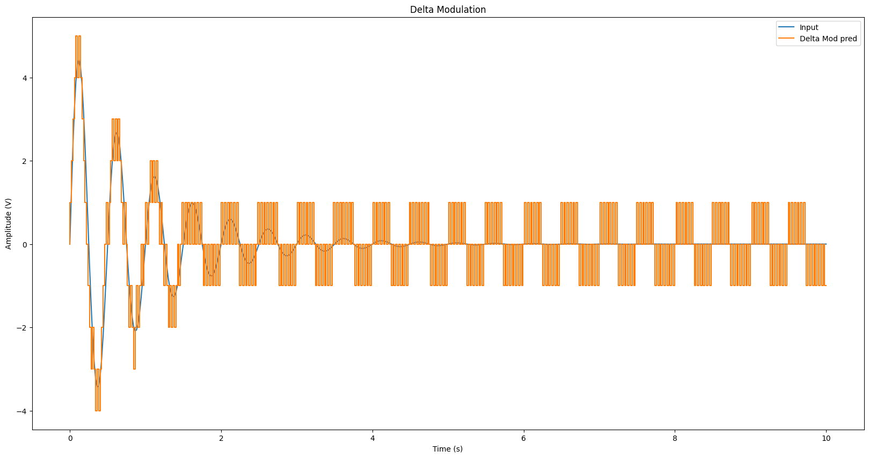
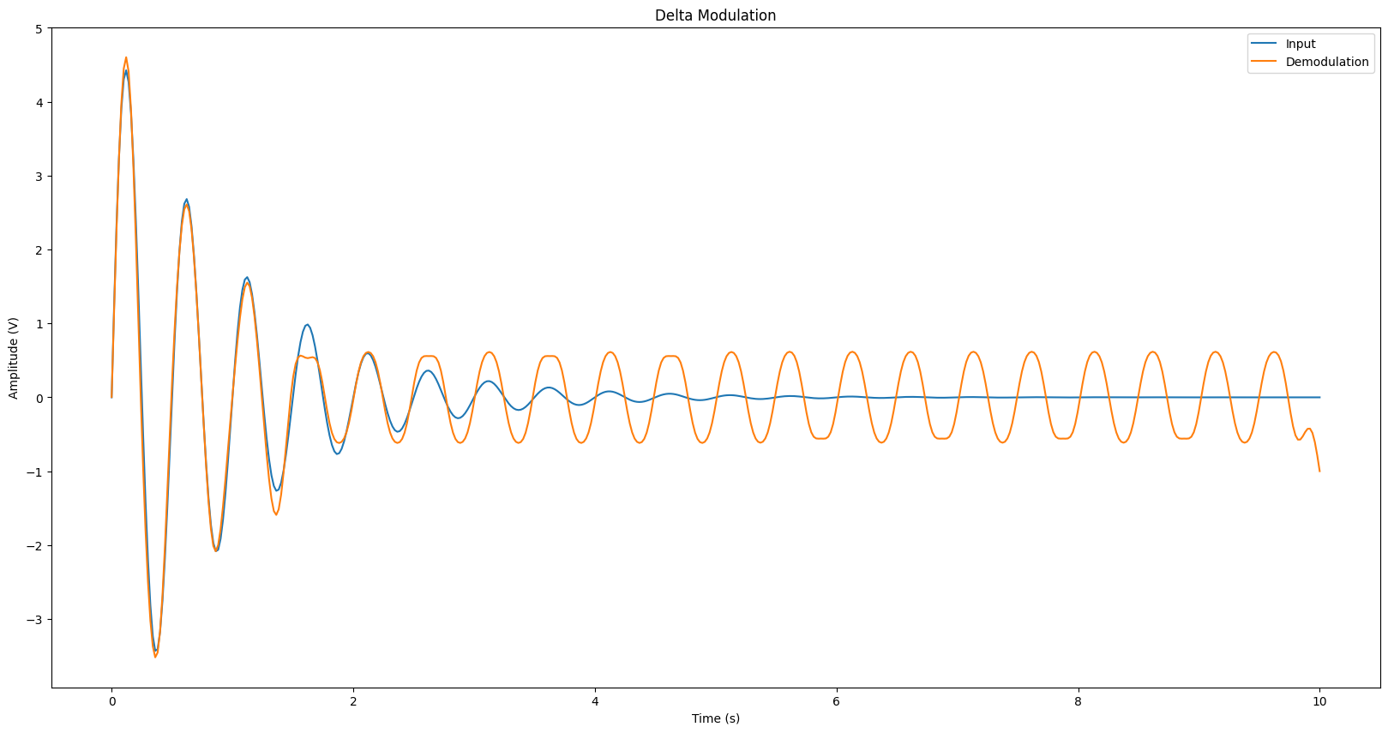
RESULTS
Delta Modulation with uniform step size
SNR: 1.574442201002264, Mean Squared Error: 0.14406363388523616

Slide 29
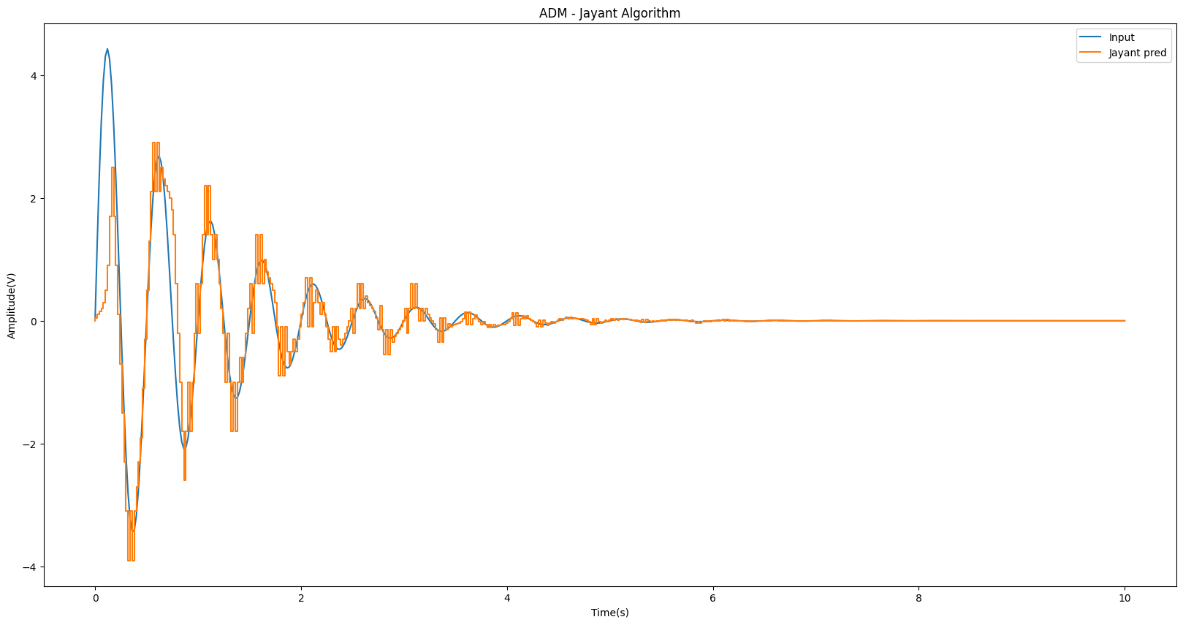
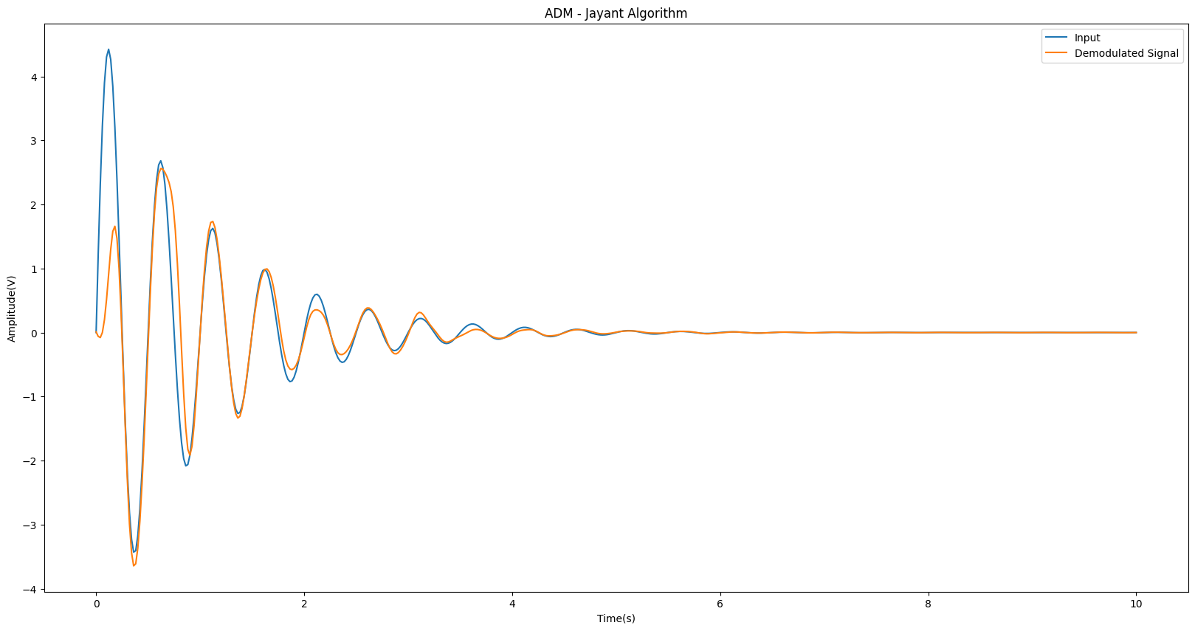
RESULTS
Adaptive Delta Modulation with Jayant Algorithm
SNR: 4.351054551478331, Mean Squared Error: 0.1952860946160476

Slide 30
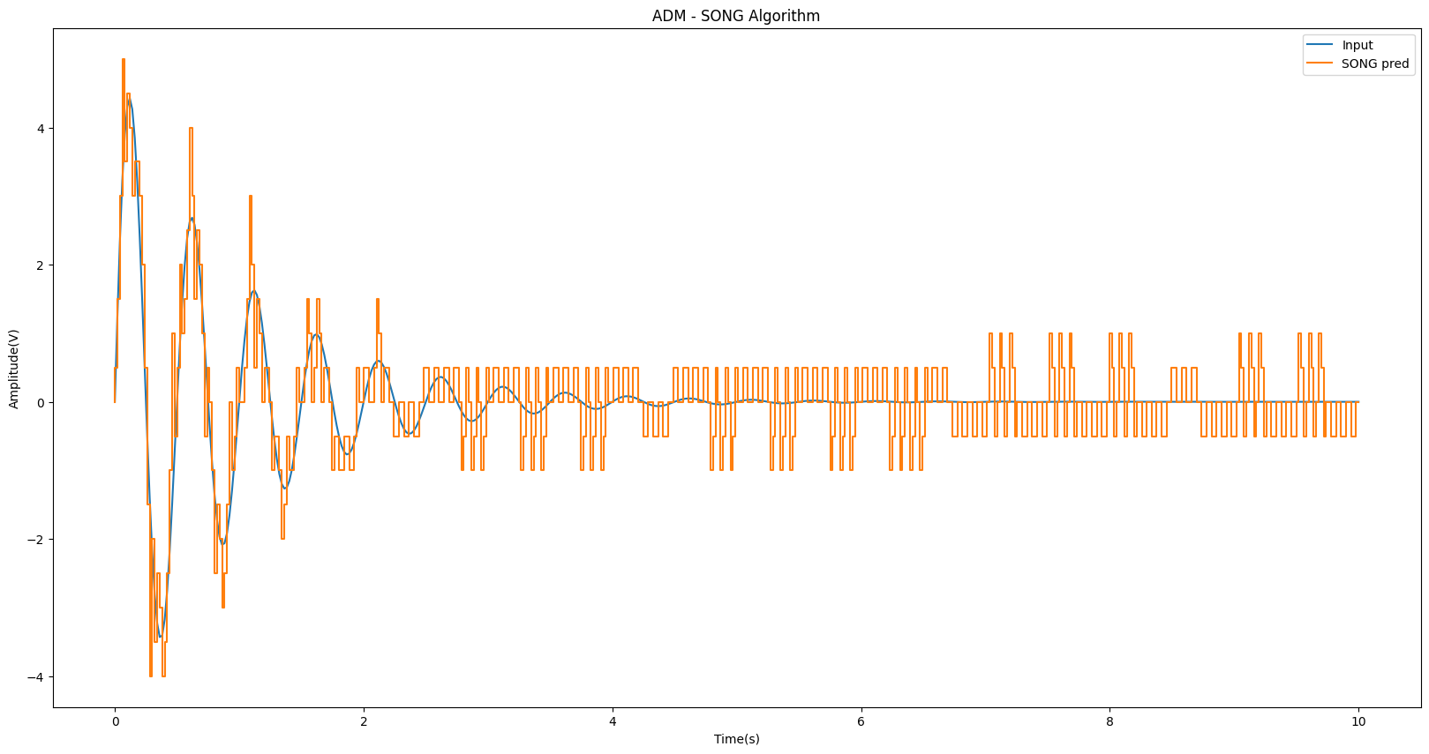
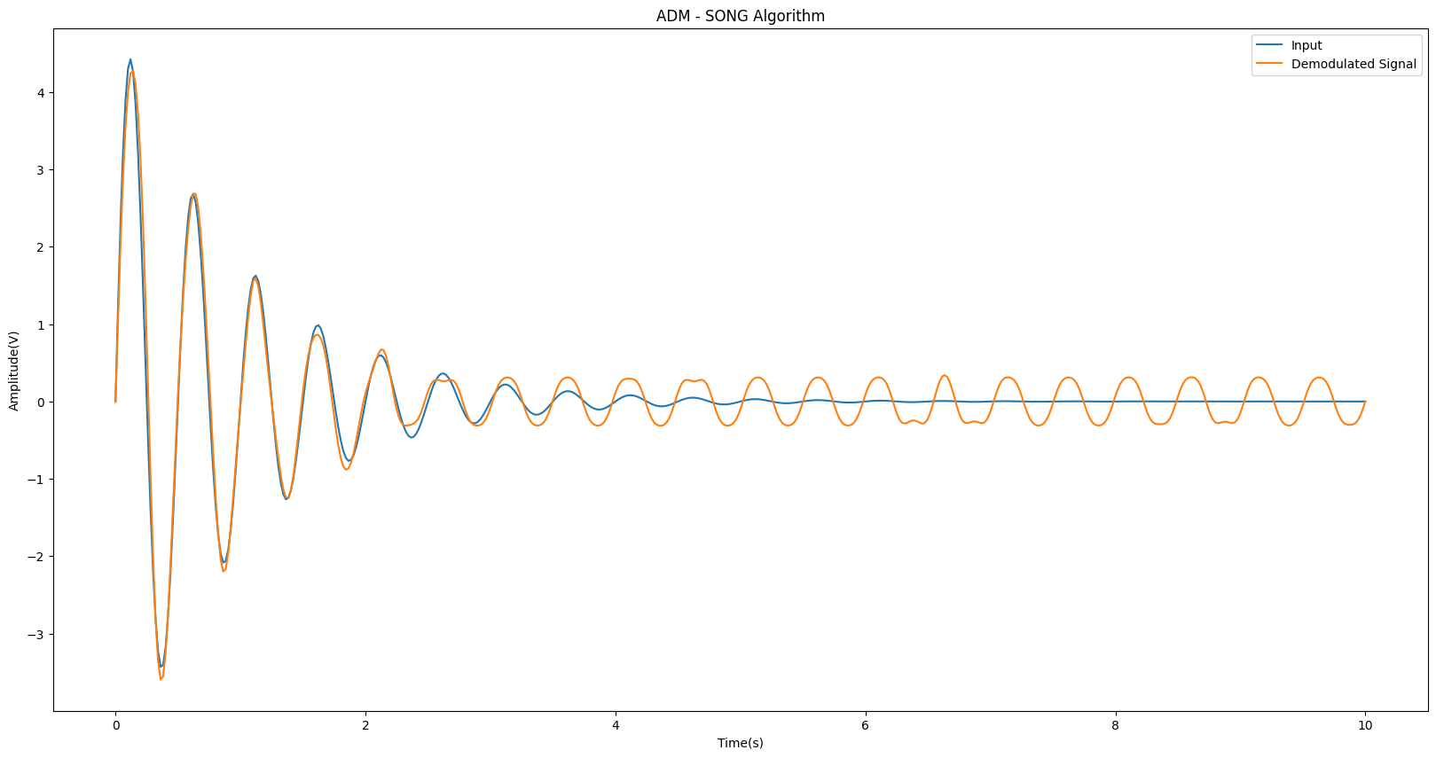
RESULTS
Adaptive Delta Modulation with SONG Algorithm
SNR: 3.850713843296499, Mean Squared Error: 0.042312810324285965

Slide 31
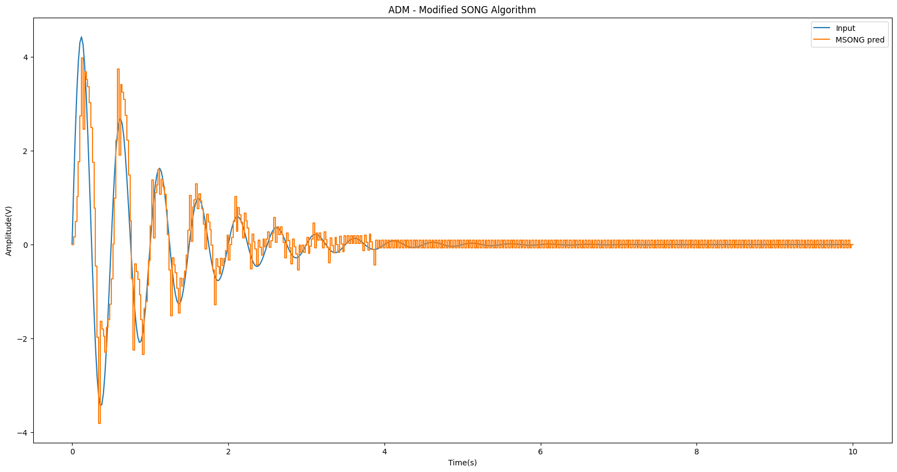
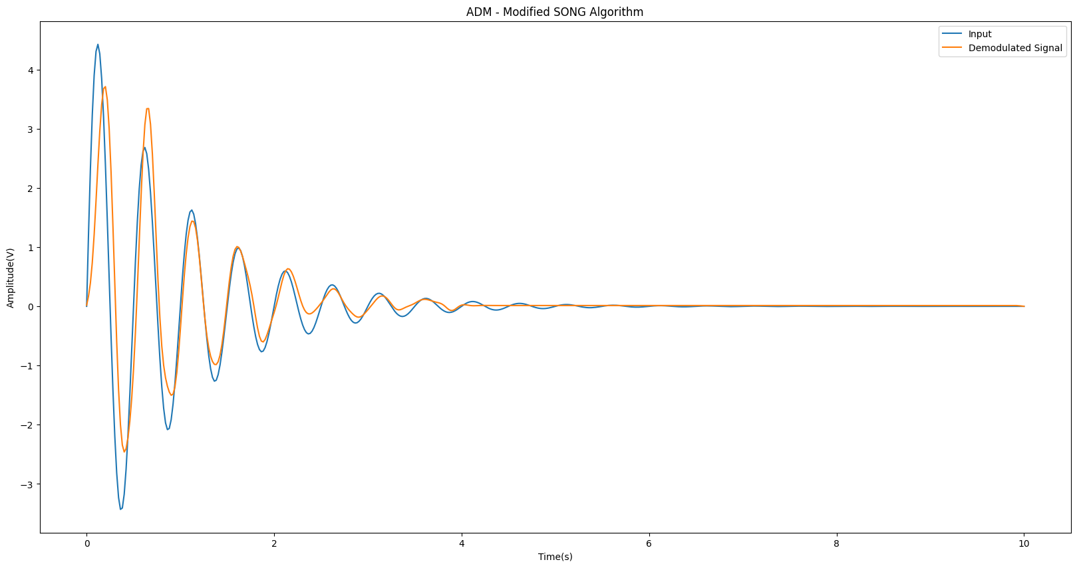
RESULTS
Adaptive Delta Modulation with Modified SONG Algorithm
SNR: 3.8564557054692967, Mean Squared Error: 0.19413964298867795

